Slide 1
Knut Sander

Slide 2
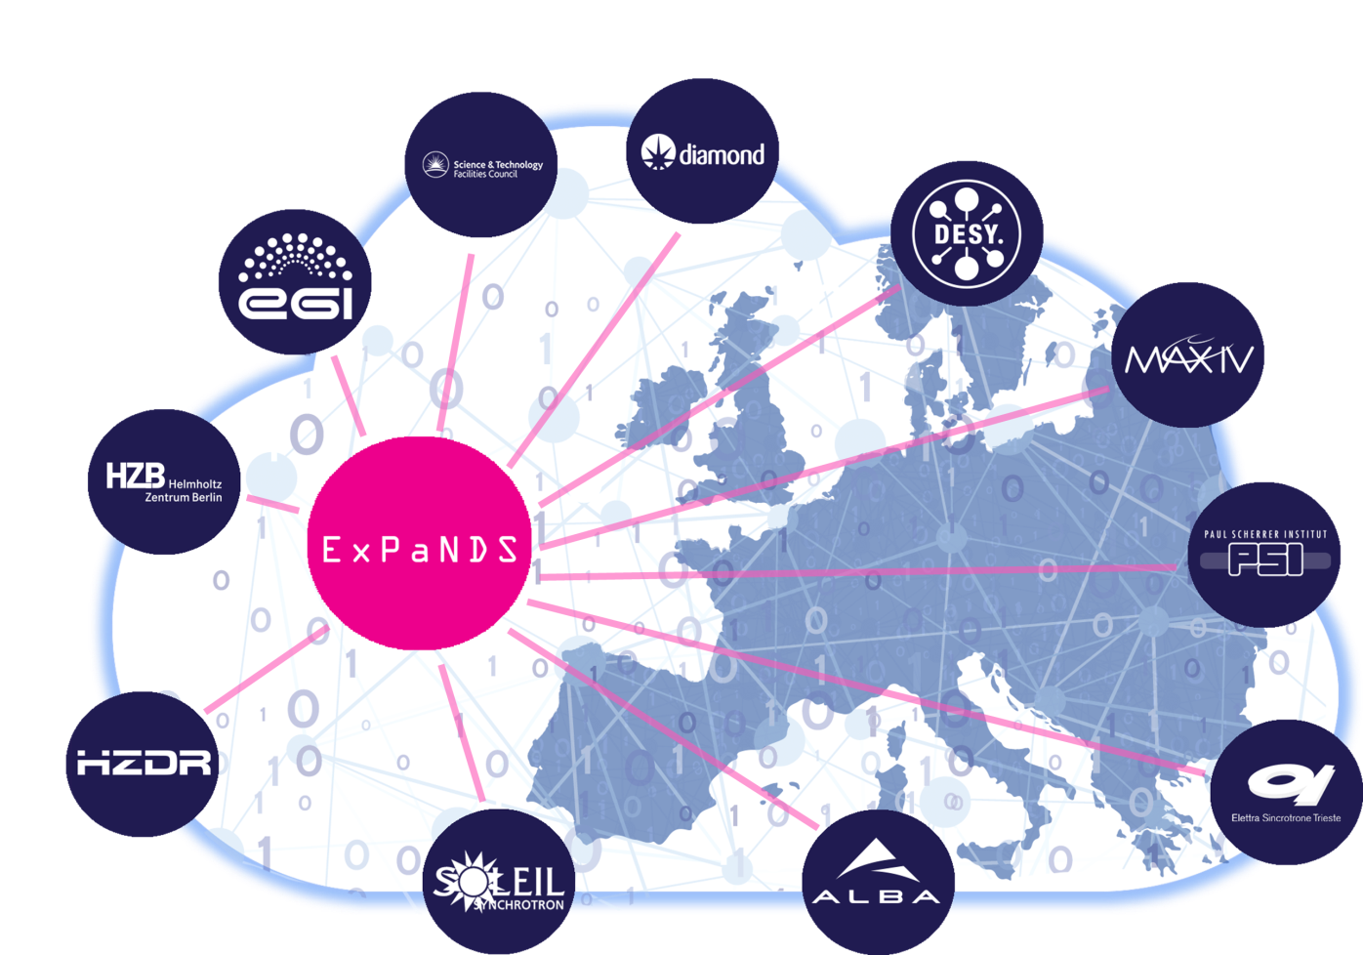
Overview
Call: Horizon 2020 INFRAEOSC-05b
Status: Started 01/09/2019
Budget: 6 M€
Duration: 3 years
Coordinator: DESY
Home page: https://expands.eu

Slide 3



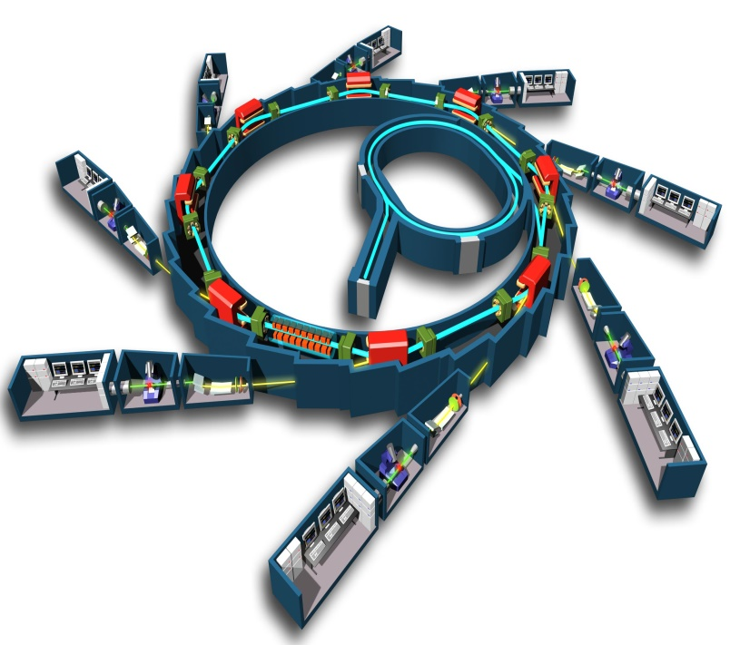




Vision
ExPaNDS will contribute to the realisation of the FAIR Data Commons for Neutron and Photon science, making it a real and productive working tool for the scientists from the numerous existing and future disciplines exploiting data from Photon and Neutron sources.

Slide 4
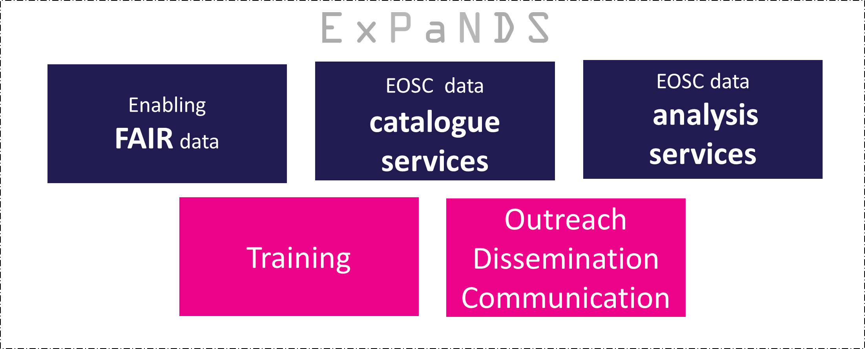
Approach

Slide 5
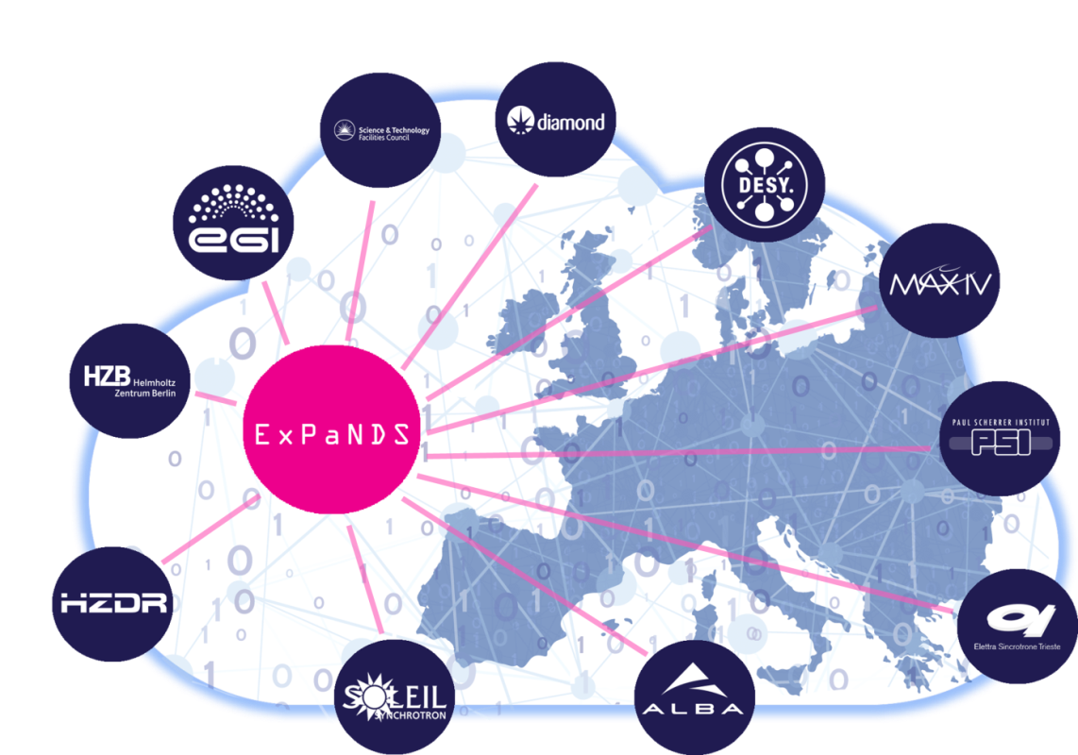







Collaboration

Slide 6
INFRAEOSC-05b Call
Coordination of EOSC-relevant national initiatives across Europe and support to prospective EOSC service providers (RIA)
support the coordination, convergence and federation of EOSC relevant national and/or thematic initiatives for open research data and services
support the gradual alignment of policies and practices of EOSC-relevant national and/or thematic initiatives to EOSC standards
enable EOSC-relevant, non-commercial services to be accessed through the EOSC portal

Slide 7
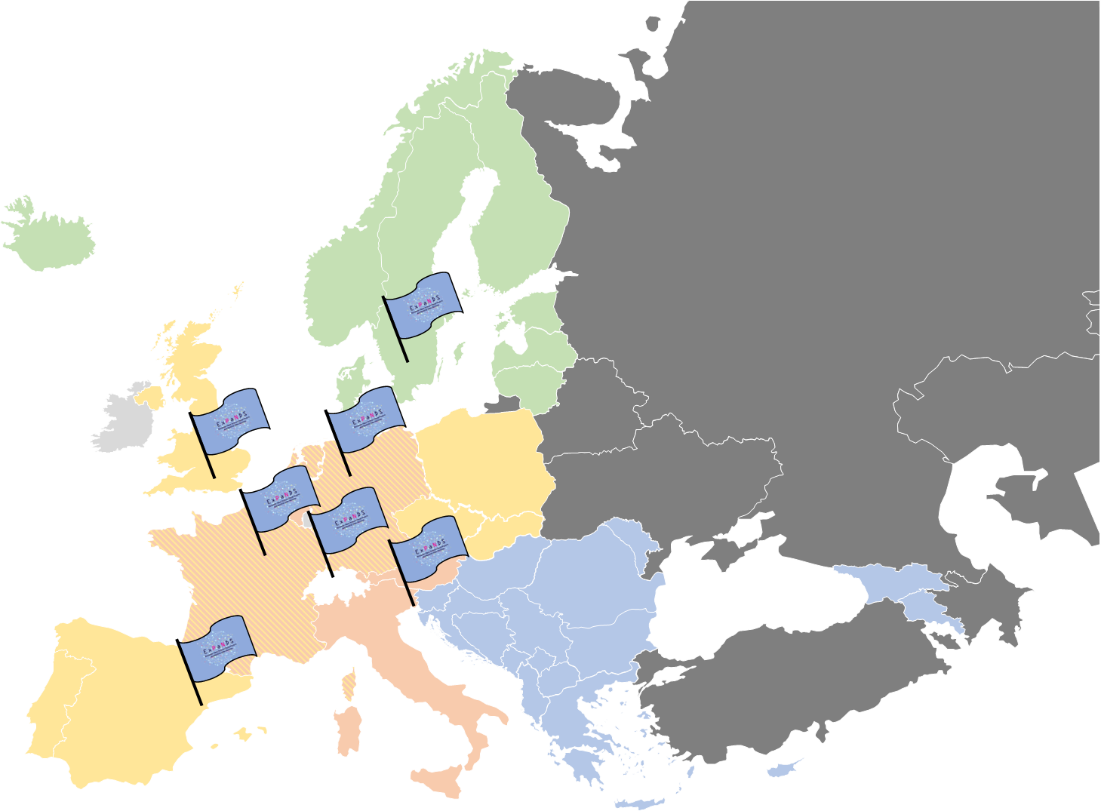
INFRAEOSC 5b projects
Landscaping
EOSC (expectation, contributing)
FAIR principles
Data policies
Services provides
Source: Federica Tanlongo, EOSC Pillar

Slide 8
Collaboration with PaNOSC
Individual projects sharing the same goals and complement each other
Prevent fragmentation of PaN community
Deliver services to every PaN RI in a coherent and integrated way
ExPaNDS
PaNOSC

Slide 9
Work Packages
 | ExPaNDS WP | Affiliate
ASHTON, Alun | WP2 | PSI
GÖRZIG, Heike | WP2 | HZB
KRAHL, Rolf | WP3 | HZB
LANG, Franz | WP4 | STFC
OUNSY, Majid | WP5 | Soleil
HILNER, Emelie | WP6 | DLS
GREGORI, Iztok |  | Elettra
KOUROUSIAS, Georgios |  | Elettra
SANDER, Knut | Coord. | DESY
Notes:
Prevent fragmentation of PaN community and deliver services to every PaN RI in a coherent and integrated way
Shares common science domain and overlapping user communities → complement each other

Slide 10
Collaboration with PaNOSC
ExPaNDS Task 2.1 related to PaNOSC WP2 on data policy
ExPaNDS Task 2.2 related to PaNOSC WP2 on DMPs
ExPaNDS Task 2.3 related to PaNOSC WP3 on metadata anthologies
ExPaNDS Task 2.4 related to PaNOSC WP2 on PIDs for instruments etc.
ExPaNDS Task 2.5 related to PaNOSC WP2 on certification of data repositories
ExPaNDS Task 2.6 related to PaNOSC WP2 & WP7 on uptake of FAIR
ExPaNDS Task 3.1 related to PaNOSC WP3 on common API and federated data catalogues
ExPaNDS Task 3.2 related to PaNOSC WP3 on PaN ontologies
ExPaNDS Task 3.3 related to PaNOSC WP3 on common API and ontologies
ExPaNDS Task 3.4 related to PaNOSC WP2 on best practices for catalogues,
ExPaNDS Task 3.5 related to PaNOSC WP6 on integrating catalogues to EOSC
ExPaNDS Task 3.6 related to PaNOSC WP2 and WP8 on documentation
ExPaNDS Tasks 4.2 and 4.3 related to PaNOSC WP4 on data analysis services
ExPaNDS Task 4.4 related to PaNOSC on common reference data sets
ExPaNDS Task 4.5 and prototypes in Task 4.6 related to PaNOSC in the context of final Task 4.7
ExPaNDS Task 4.7 related to PaNOSC WP6 on integrating services to EOSC
ExPaNDS Task 5.1 related to PaNOSC WP8 on user training
ExPaNDS Task 5.2 related to PaNOSC WP8 on e-platform + training material
ExPaNDS Task 6.1 related to PaNOSC WP9 on common communication strategy
ExPaNDS Task 6.3 related to PaNOSC WP7 on common KPIs

Slide 11
Collaboration with PaNOSC
PaNOSC
Cat. Service
Deliverable
PaNOSC
Analysis
Deliverable
WP3: Deliver Catalogue services through EOSC
WP4: Deliver analysis services through EOSC
Start of ExPaNDS
WP2: Enable FAIR Principles at RIs
WP5: Develop and Deliver Training
EOSC Photon and Neutron Services
WP6: Develop and Deliver Outreach Policy
WP1: Develop Sustainability Model

Slide 12



Collaboration with PaNOSC
Table of people working together on linked tasks | Under development
Sign up to the appropriate mailing lists | finalised | Starting (e.g. WP3)
Attend common meetings, perform common workshops | (e.g. WP3)
Mutual observer status () | Partly | Starting
Coordinating deliverables and milestones | Under development (done e.g. for WP6 WP3)
Share deliverables
Share databases of stakeholders and dissemination | Partly | Starting
Project Websites linked to each other | Yes | Under development
Common events calendar
Coordination of EOSC related activities | Starting

Slide 13

Cooperate with the EOSC governance bodies
EOSC Executive Board
EOSC Working Groups
Landscape
FAIR
Architecture
Rules of Participation
Sustainability
Collaboration Board
EOSC Liaison Board
Project Coordinator
Technical Coordination Board
Project Executive Board

Slide 14

Thank you

